Slide 1
The book of _____
Your name / comment here

Slide 2
Author
Who authored the book? Was it a collaborated effort?
Notes:
Ref: Archaeological Study Bible

Slide 3
Audience
Who was the audience? To whom was the author writing? Who is the audience now?
List references in the Power Point notes as appropriate
Notes:
Ref: Archaeological Study Bible

Slide 4
Cultural facts
Describe the place where the events took place.
Notes:
Ref: Archaeological Study Bible

Slide 5
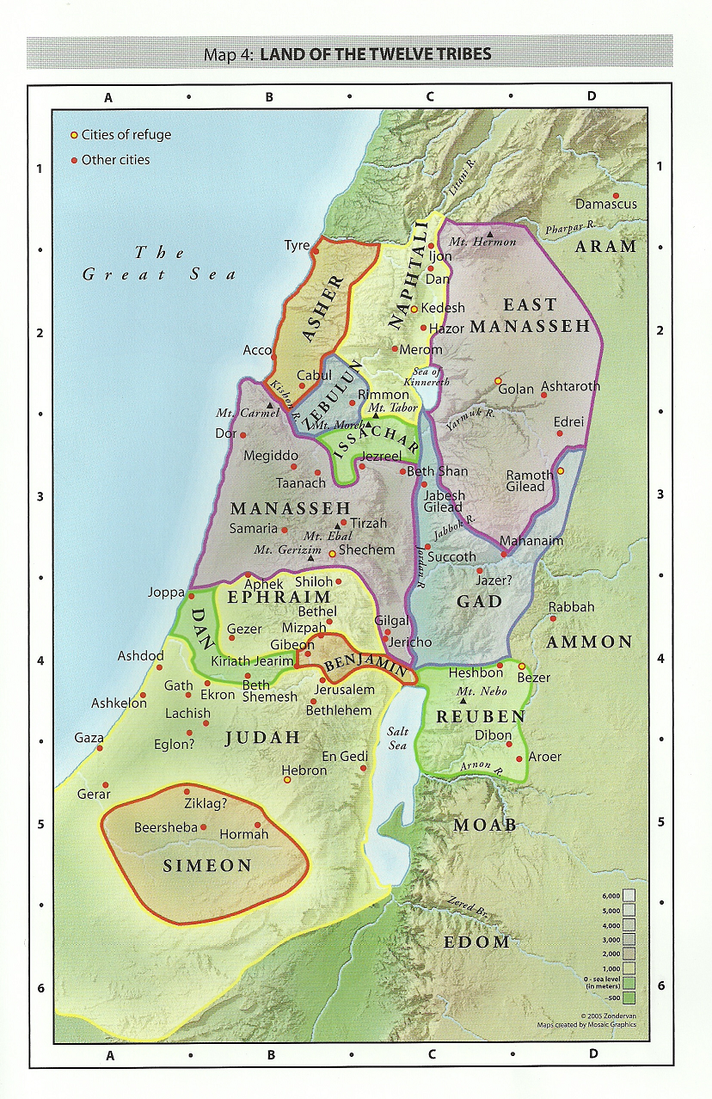
map
Find a map applicable to the book.
Notes:
Ref: Map is from the Zondervan Archaeological Study Bible

Slide 6
Timeline
Timeline of events. Many of the dates are approximate. That’s OK. The important thing is putting them in order for a quick summary and to place them relative to other events.
Notes:
Ref: Timeline is from the Zondervan Archaeological Study Bible, dates are approximate based on the Bible and Archaeological evidence.

Slide 7
Chapter 1
Outline of the book: “Cliff’s Notes” style. How does your book tie in with other books of the Bible?

Slide 8
Chapter 2

Slide 9
Chapters 3-12

Slide 10
Chapters 13-16

Slide 11
Chapters 17-21

Slide 12
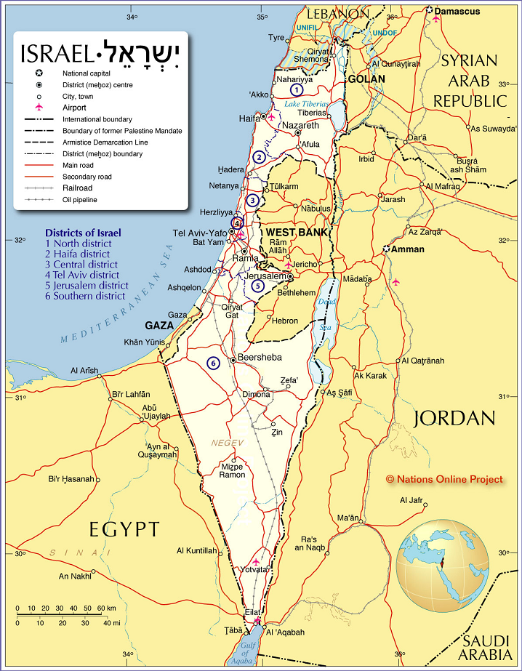
Modern-day israel
How is the book applicable today?
Notes:
Ref: current map of Israel from the internet.

Slide 13
Popular references
How is the book referenced in modern popular culture? How are some of the stories and teachings applicable today?
Notes:
Ref: Google! ☺

Slide 14
Catholic church
What does the Catholic church teach about this book of the Bible?

Slide 15
Discussion…
Questions?

